Slide 1
HARDWARE AND COMPONENTS

Slide 2
1. Hall effect sensor
2. Bread board
3. Arduino

Slide 3
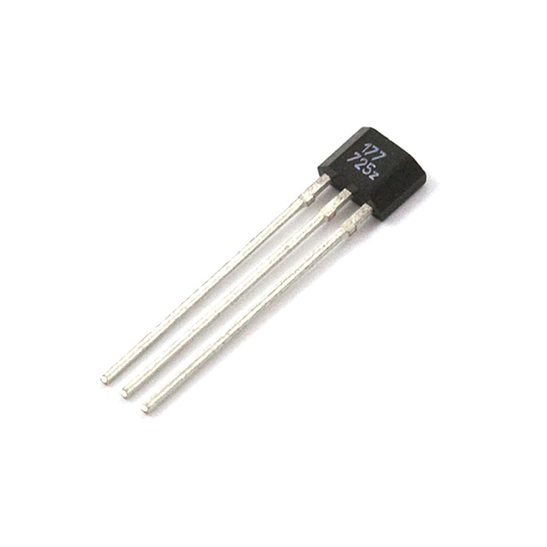
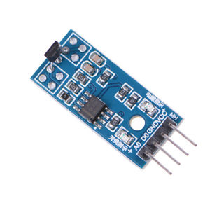
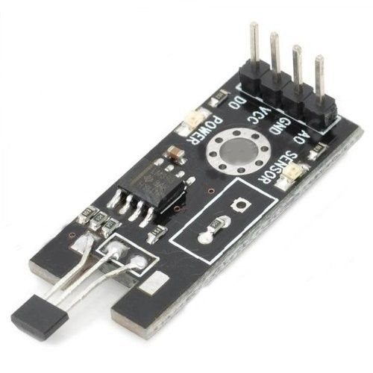
1. Hall effect sensor
Hall Effect Sensors consist basically of a thin piece of rectangular p-type semiconductor material such as gallium arsenide (GaAs), indium antimonide (InSb) or indium arsenide (InAs) passing a continuous current through itself.

Slide 4
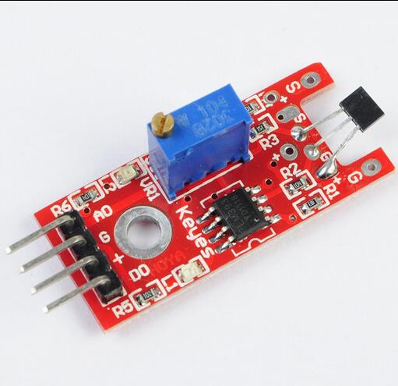
Here we have used linear magnetic Hall sensor LM393
Pins:
VCC ↔ 3.3V ~ 5.3V
GND ↔ power supply ground
A_{OUT} ↔ MCU.IO (analog output)
D_{OUT} ↔ MCU.IO (digital output)
Operating Voltage(VDC) | 3.3 to 5
Length (mm) | 35
Width (mm) | 15
Height (mm) | 14
Weight (gm) | 3
Shipment Weight | 0.01 kg
Shipment Dimensions | 4 x 4 x 2 cm

Slide 5
The various parts of the LM393 are
Sensitivity
adjust
Hall sensor
Analog output
GND
VCC 3.3 - 5V
Digital output
Power indicator LED

Slide 6
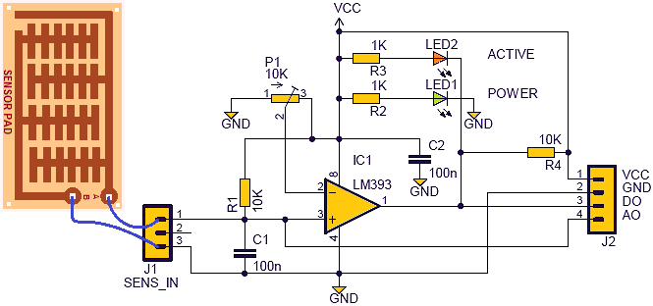
The LM393 provides both Analog as well as digital output through A0 and D0 pins respectively.
The circuit diagram is

Slide 7
What is BREADBOARD?
A breadboard is a construction base for prototyping of electronics. Originally it was literally a bread board, a polished piece of wood used for slicing bread.
the solderless breadboard does not require soldering, it is reusable. This makes it easy to use for creating temporary prototypes and experimenting with circuit design.
Older breadboard types did not have this property.

Slide 8
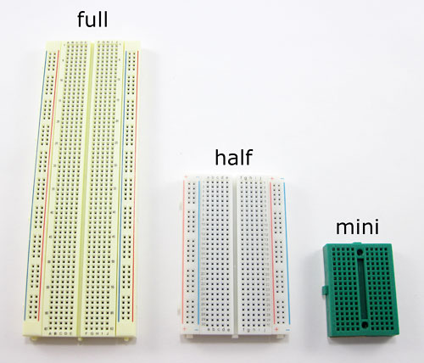
Types of Breadboards?

Slide 9
Why are bread board used for?
A breadboard is used to build and test circuits quickly before finalizing any circuit design. The breadboard has many holes into which circuit components like ICs and resistors can be inserted.

Slide 10
How are the holes in a breadboard connected?
The top and bottom rows (the rows indicated by the blue) and are usually the (+) and (-) power supply holes and these move horizontally across the breadboard, while the holes for the components move vertically Each hole is connected to the many metal strips that are running underneath. Each wire forms a node.

Slide 11
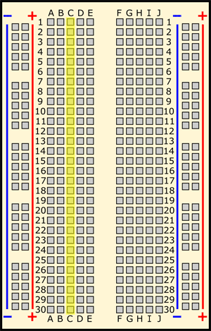
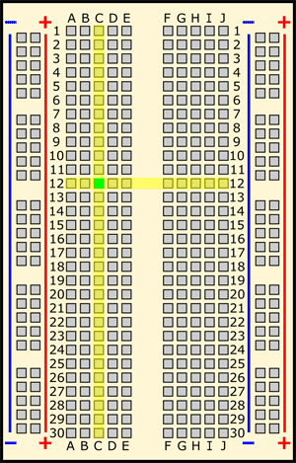
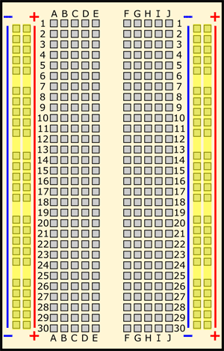
These strips are typically marked by red and blue (or red and black) lines, with plus (+) and minus (-) signs, respectively. They are called the buses, also referred to as rails, and are typically used to supply electrical power to your circuit when you connect them to a battery pack or other external power supply. You may hear the buses referred to by different names
There is no physical difference between the positive and negative buses, and using them is not a requirement. The labels just make it easier to organize your circuit, similar to color-coding your wires.

Slide 12
What are jumper wires and what kind should I use?
Jumper wires are wires that are used to make connections on a breadboard. They have stiff ends that are easy to push into the breadboard holes. There are several different options available when purchasing jumper wires.
Flexible jumper wires are made of a flexible wire with a rigid pin attached to both ends. These wires usually come in packs of varying colors. This makes it easy to color-code your circuit (see the section on color-coding). While these wires are easy to use for beginner circuits, they can get very messy for more complicated circuits; because they are so long, you will wind up with a tangled nest of wires that are hard to trace

Slide 13
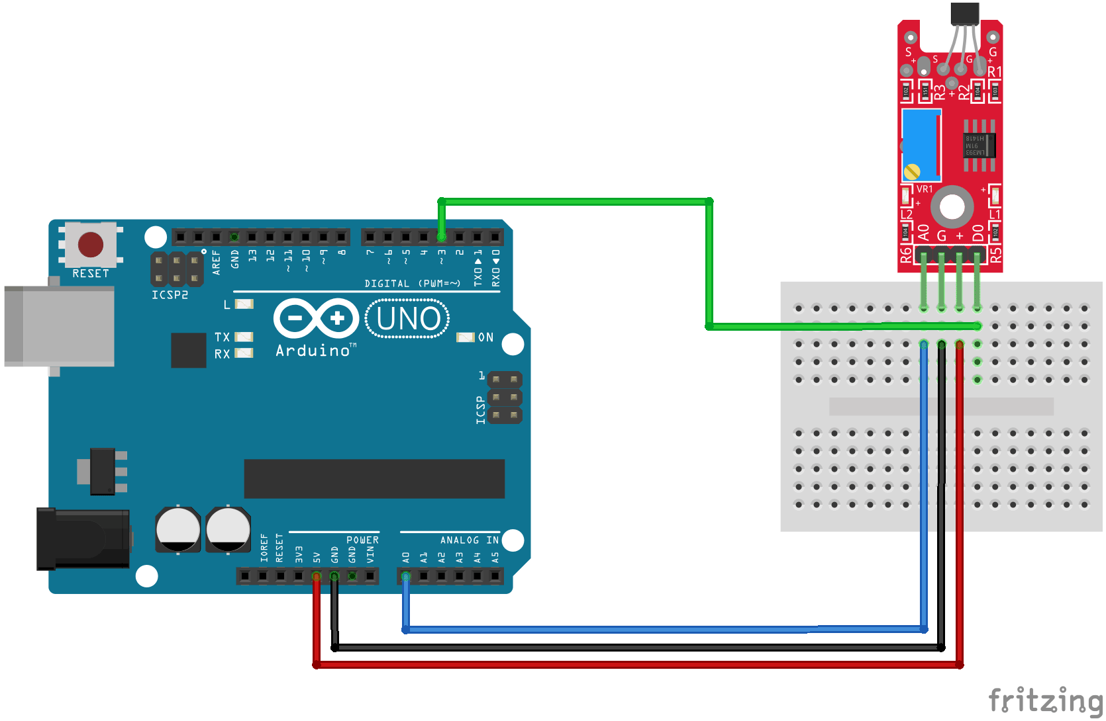
ARDUINO CONNECTION

